Slide 1
Raising your teaching game
Helping children to learn better

Slide 2
Starting with a song
Salibonani – a Hello song from Zimbabwe
Our actions were:
Walk on beat x 4
Knee knee chest chest clap hands out (hands out became a tap on partner’s hands)
Teach the song marching on the spot then move around the room
Musical Concepts – pulse, rhythm, phrase length

Slide 3
Aims of session
to provide an opportunity to reflect on and share good practice
to examine and experience strategies for collaborative learning
to discuss how to incorporate collaborative learning strategies into your teaching

Slide 4
Reflective practice
“We do not learn from experience – we learn from reflecting on experience” – John Dewey
How to become an expert teacher? – adapt and develop
How can ArtForms support you?
Notes:
John Dewey, american educationalist and philosopher – view of education of need to learn by doing; believed that humans learn through a hands-on approach
how do artforms provide opportunities for reflection – CPD – opportunities to reflect – RS last year, competent learners and being awake to learning, peer network last year;
dept facebook or whatsapp groups; team meetings, peer relationships, informal opps; PD procedure; spare eyes – informal support (mentioned last year – problem Y9 class, use of language) and formal lesson observation

Slide 5
Time to reflect
What did you implement from last year’s learning and what was the impact?
Spend a moment or two thinking, then share your thoughts with your table
Notes:
What have you adapted / developed and how has your teaching developed?
prompt on next slide

Slide 6
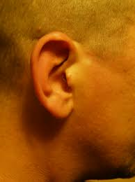
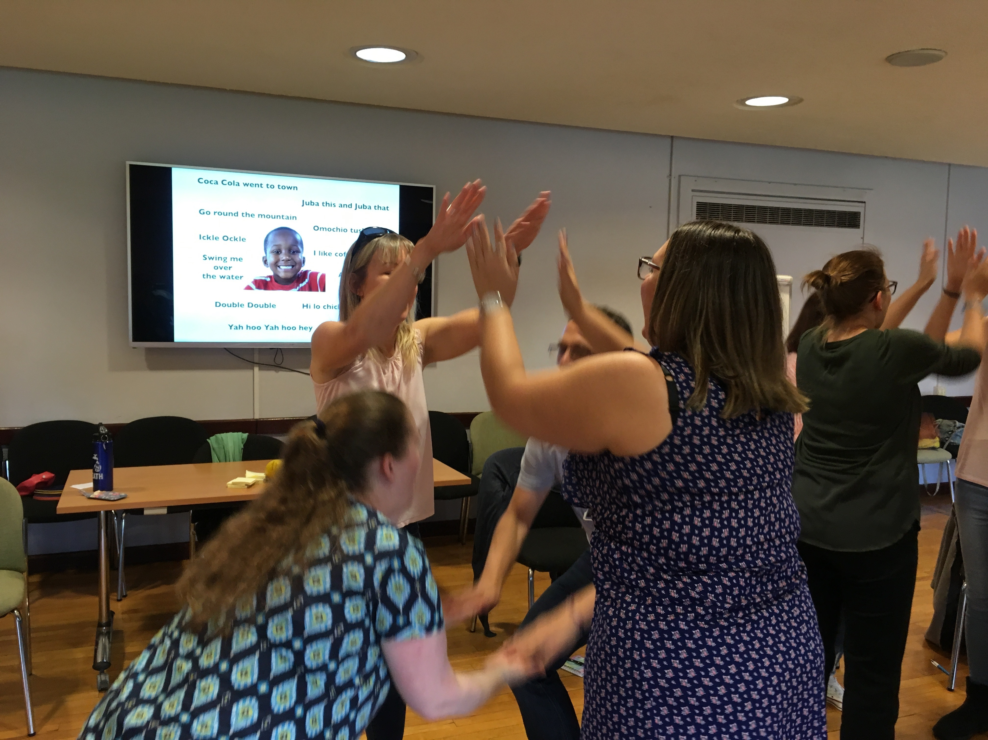
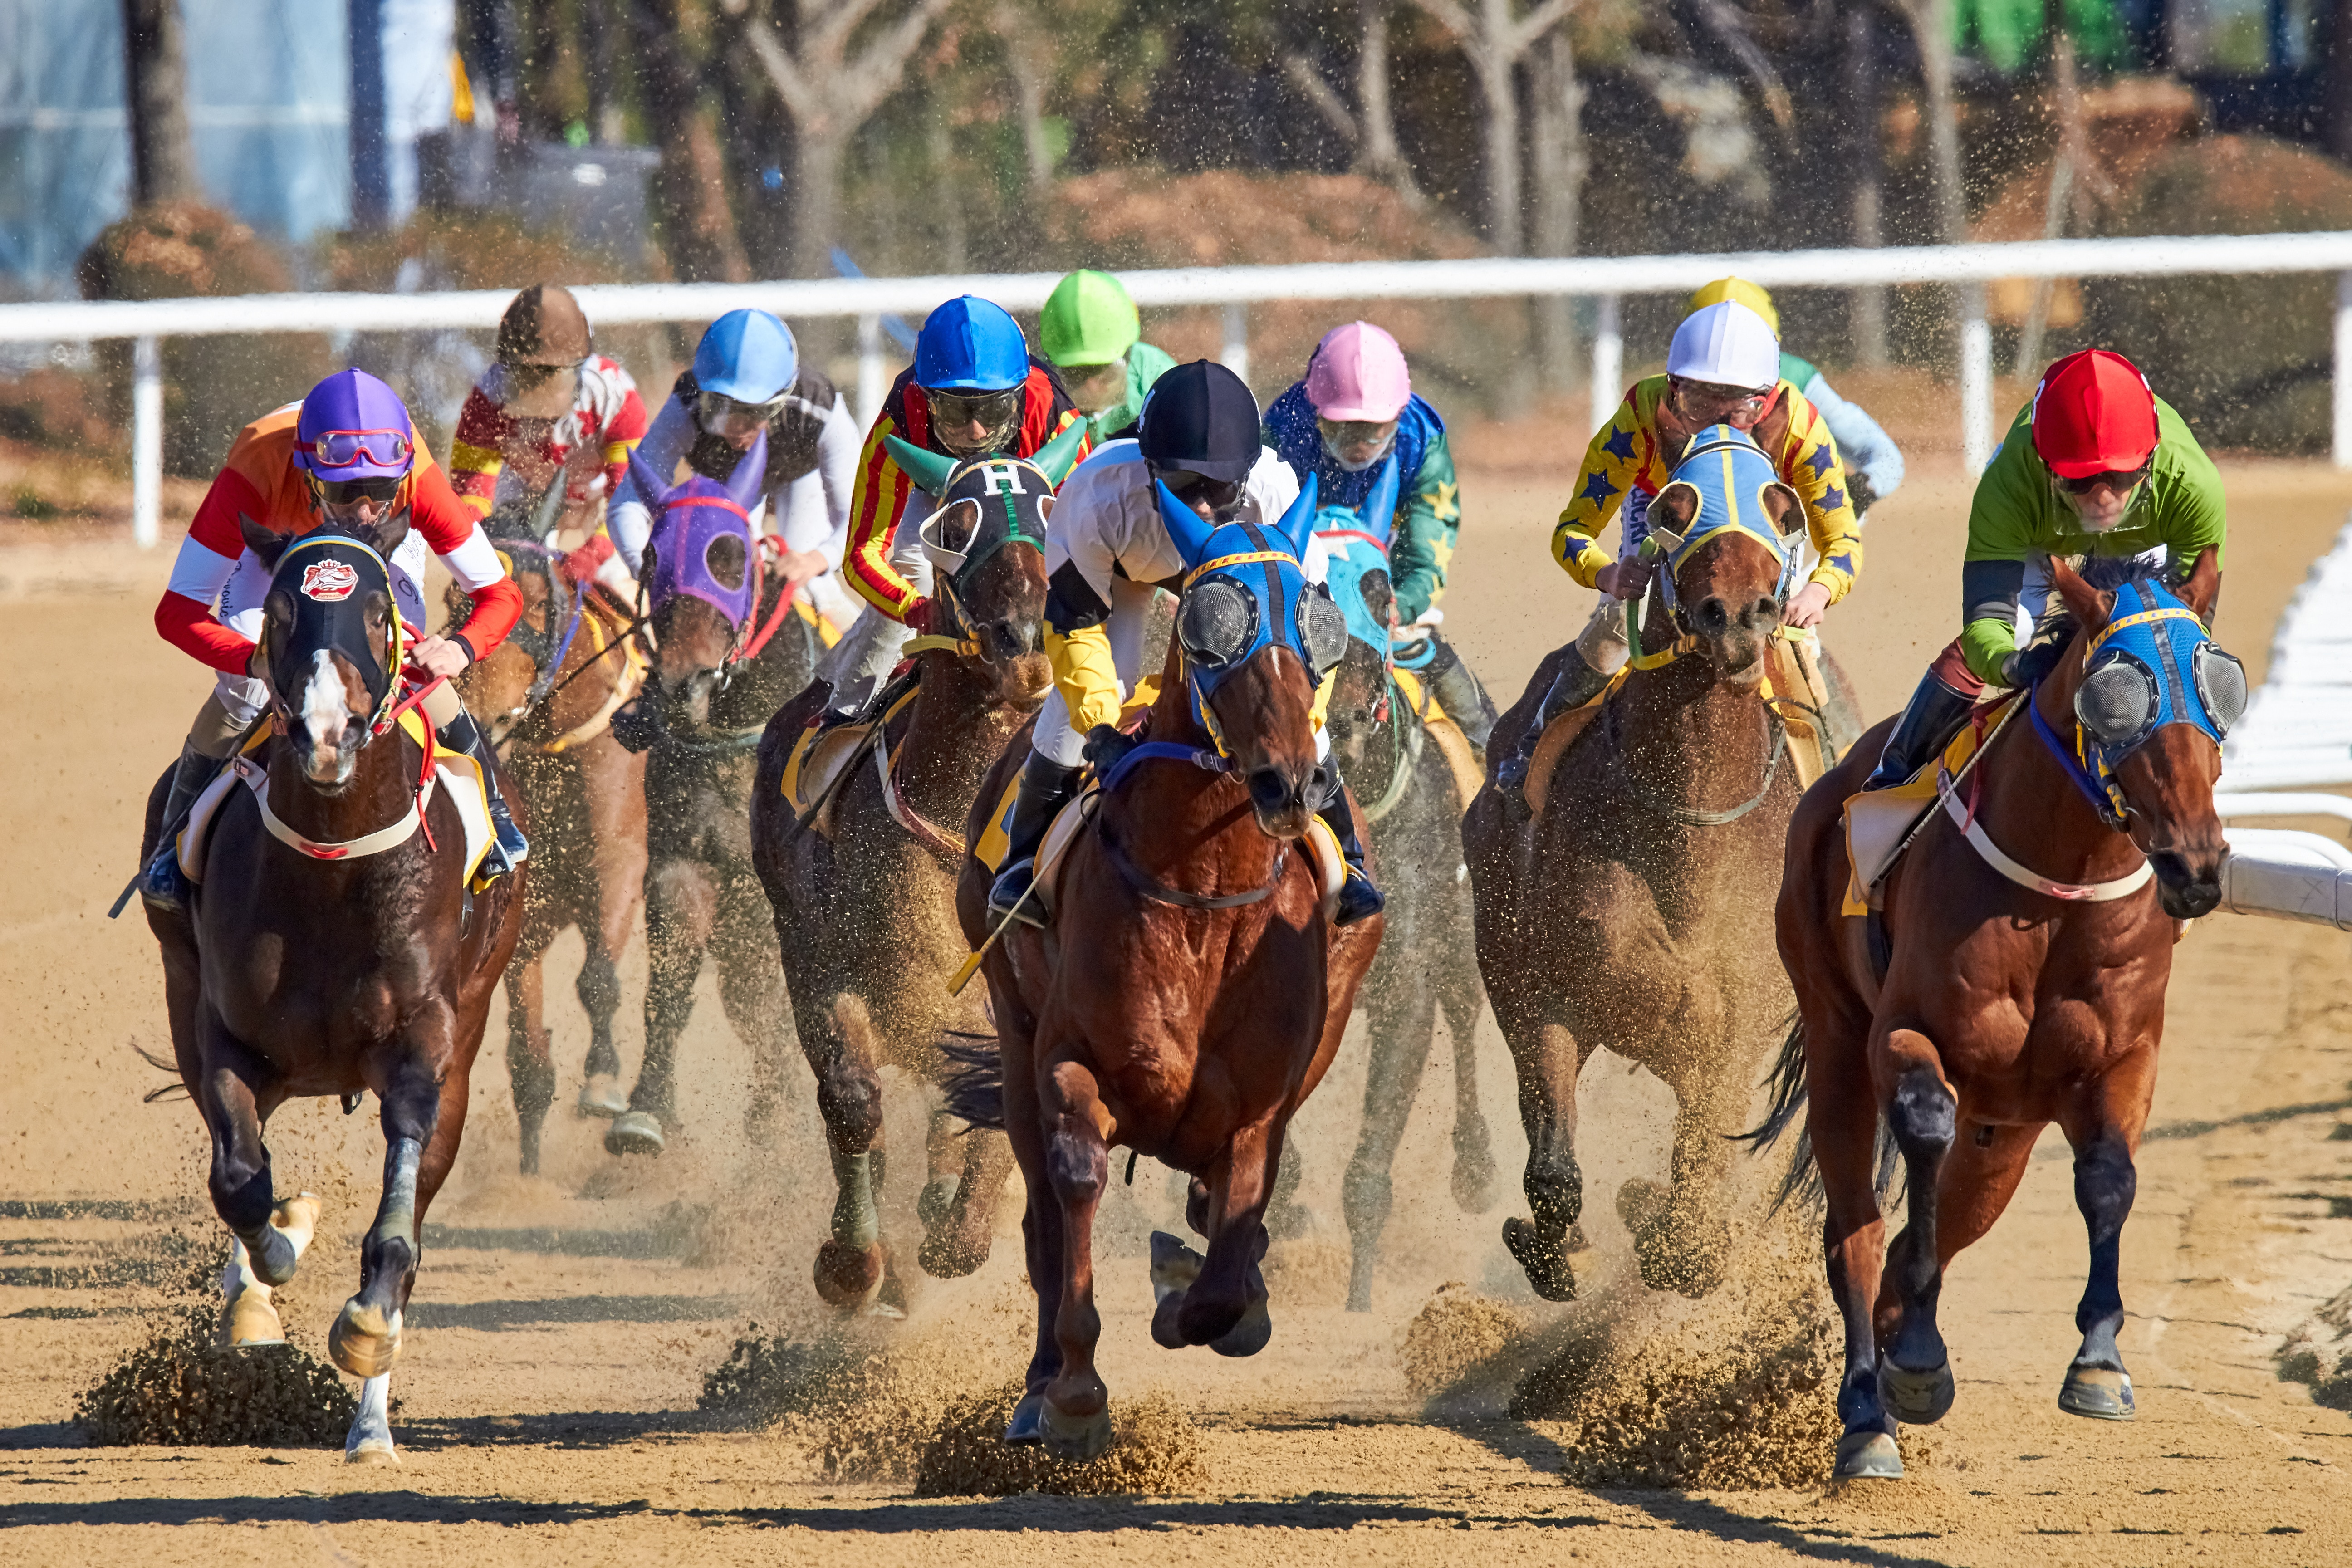
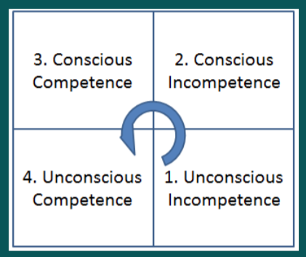
September 2019
The answers are in the room
Notes:
review of the year – focus on teaching rather than other activities (concerts etc)
how did last year’s training (or any other training / observations / peer sharing) impact on your teaching?

Slide 7
Time to reflect
What did you implement from last year’s learning and what was the impact?
Spend a moment or two thinking, then share your thoughts with your table
Notes:
What have you adapted / developed and how has your teaching developed?
prompt on next slide

Slide 8
Plenary
Think back to the song at the start of the session – how did we learn the song?
In a pair tell each other which strategy you identified.
Share your strategy with the rest of the group – and brainstorm to identify up to 10
Notes:
recap my session (plenary) – back to song (which I took from last year’s learning)
examine how we worked
what if group work goes wrong – learn how to work co-operatively – smaller groups; or group roles – leader, encourager, resource manager, timekeeper, recorder/writer

