Slide 1
WCET - Not Just Performing
Monday 3rd September
1.30-2.45pm

Slide 2
Aims of this session
Recap expectations of Whole Class Instrumental teaching
Explore ways of incorporating composition into WCIT through Singing and Listening
Provide opportunities for discussion / sharing with colleagues

Slide 3
Expectations in WCIT
Whole Class Instrumental Teaching - teaching music via the instrument, not just (for example) about teaching how to play recorder;
WC colour awards allows for breadth – expectation for all staff to use whole class colour awards in their teaching
For most classes, this will be their only music provision during the year – have an awareness of National Curriculum expectations for the year group you are teaching

Slide 4
National Curriculum expectations:
AF Progression and Assessment Document (in Staff Room area on ArtForms website)
4 pillars – Performing, Composing, Listening, Reviewing; 5th pillar – Singing
Year 3 Expectations:
I can create and perform simple rhythmic and melodic patterns as part of a team
I can share ideas and listen to others when working on a composition
I can explore and create melodies that use steps and leaps and a wider range of notes
I can select a sound or instrument to achieve an effect, e.g. quiet playing on chime bars to create something peaceful

Slide 5
Composing Activities in WCIT
Why Compose? – opportunities for children to work independently /pairs / groups; allows children to have control of their learning; allows children to consolidate and develop their learning; addresses issue of too much teacher led time
Who includes regular composing activities within whole class learning?

Slide 6
When is a song more than a song?
Clarinet Café – Ellen Carter
Examples of activities - Choose the food or drink that you would like to see on the menu and use these to create rhythmic and melodic ostinato. Create a class piece of music layering ostinato.
How else could you use this song?
Notes:
We don’t have time to teach endless amounts of repertoire – plus children need a degree of repetition. The secret is how you use the songs that you teach to get the most out of a song.

Slide 7
Starting with a Song
Discuss and share examples of activities that you use (or could use) which start with a song and allow children the opportunity to respond creatively through improvising or composing

Slide 8
Starting with a song
Eg – I hear Thunder (Ukulele Magic)
Create watery word ostinati to accompany the song
Create soundscape of rhythms or melodies using watery words - splish splash, splosh, pitter patter
Add rap section

Slide 9
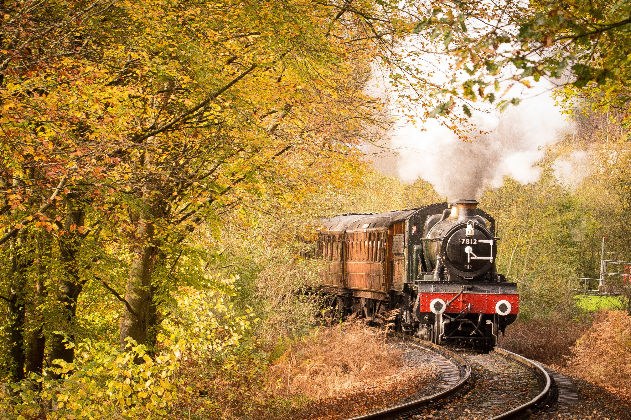
Active Listening Activity
Audio

Slide 10
Active Listening Activity
Get your sticks ready!
Audio

Slide 11
William Tell Overture Finale
Structure
A A B C A A end
Audio
Class version:
https://www.youtube.com/watch?v=F80LKTinhJE

Slide 12
William Tell Overture Finale
https://www.youtube.com/watch?v=YIbYCOiETx0
Melodica Men:
https://www.youtube.com/watch?v=zSLEZU3o9jI

Slide 13
William Tell Overture Finale
Create group piece about horse racing using the 2 notes that you know on your instrument and also voice / body percussion.
Things to think about:
Structure of your piece
Who will be your conductor?

Slide 14
T’aint what you do, it’s the way that you do it
Ask one child to tell me what they have to do before they start the task
Model/demonstrate task – clarify what you’re looking for, ask for ideas; eg confirm structure – beginning, middle, end
Break down task into appropriate and manageable chunks – NOT “Create a group piece using ostinato”
Groups – who chooses? What criteria? – allows you to put support where needed
Sample progress – what’s good so far, how could it be improved?
Before performing – who is counting in? where is the performance area?
How to structure performance – all individually, following one after another without a gap, groups performing together, comment at end
Listening criteria – what are we looking for? 2 stars and wish, who likes it? what do you like about it? Point to your favourite group

Slide 15
Time to reflect
Do you have a balance of learning opportunities in your WC (or other) lessons?
Do children have the opportunity to respond creatively in your lessons?
What’s going well that may be developed further?
Questions?
Paula.Brookes@leeds.gov.uk

